Slide 1
Stability and Mantid
Anthony Lim,
4th April 2019,
Mantid User meeting,
ILL

Slide 2
Contents
What is stability
How to make reliable software
How to stop regression
Error reporting
Improving stability
Project recovery
Support from Mantid

Slide 3
What is stability?

Slide 4
What is stability?
Doesn’t behave unexpectedly
Is supported
Works on ‘common’ operating systems
Backwards compatible
Consistent results
Doesn’t crash/freeze

Slide 5
How to make reliable software
Use coding standards – so others can easily develop the code
Verification
Code review and testing
beta (user) testing
Unscripted testing
Acceptance testing (from users)

Slide 6
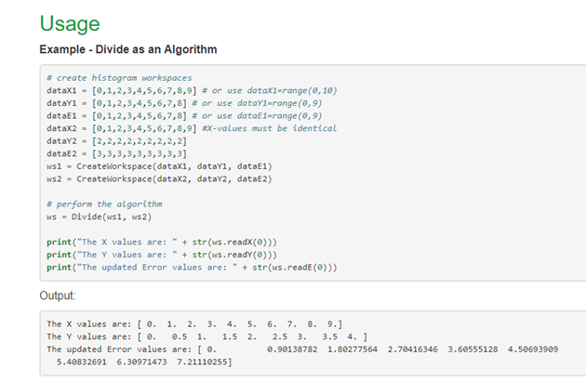
How to make reliable software
Automated tests – we know if future changes ‘break’ the code
System tests
Unit tests
Doc tests
Automated standards
Clang format
cpp check
flake8

Slide 7
How to make reliable software
Use only supported software and operating systems (OS’s)
Mantid 4.1 will be the last to support Windows 7
Removing dependencies on Qt4
Prepared to move from Python 2 to Python 3
To ensure stability want to upgrade software before it is necessary - workbench

Slide 8
Development process and stability
Understand requirements and theory
Write code to do calculation
Verify code is correct
Write unit tests and documentation
Code review and developer testing
Made available in the nightly
Review improvements

Slide 9
How to stop regression
Unit tests and system tests
Unit tests – for individual fitting functions and algorithms
System tests – Longer calculations
Can check for a given input the output does not change unexpectedly

Slide 10
Error reporting

Slide 11
Error reporting

Slide 12
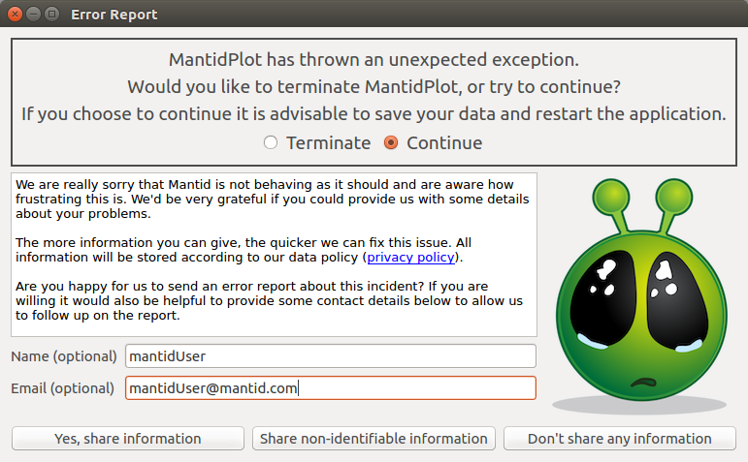
Error reporting
Will always have some reports
There are 6 daily tests for the error reporting
We cannot fix if we do not know about it
Have successfully fixed some crashes

Slide 13
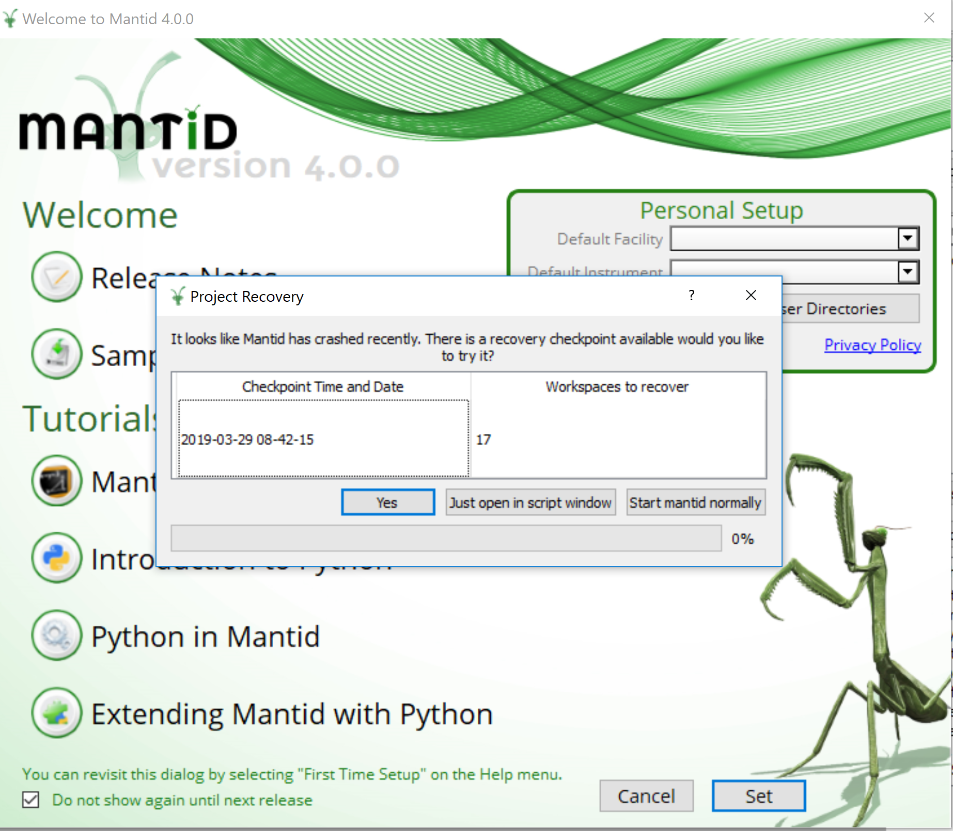
Project recovery
If all else fails want to make easy to restore Mantid
Need history of workspaces
Need to be able to save GUI states for GUI’s to work

Slide 14
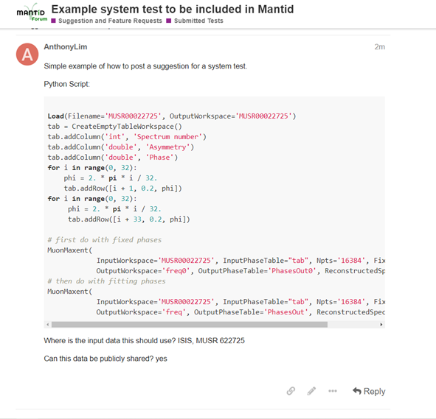
Improving stability
Added a new category to the forum:
Submitted Tests
Has a template for you to fill in
We will let you know when it is in master

Slide 15
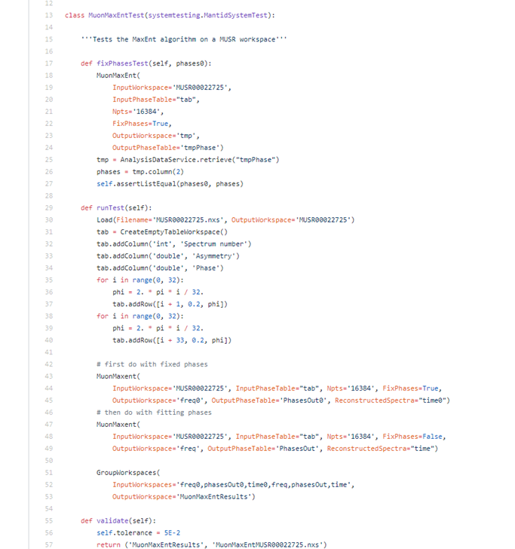
Improving stability
Can test against various things
Here we test the outputs:
Frequency spectra
Outputted phases
Reconstructed time domain data
If there is something in particular you want to test let us know

Slide 16

Support from Mantid
Stability is important to Mantid team
We are recruiting for a new support role at ISIS
Rapidly responding to forum posts
Follow up on error reports
User training

